Slide 1
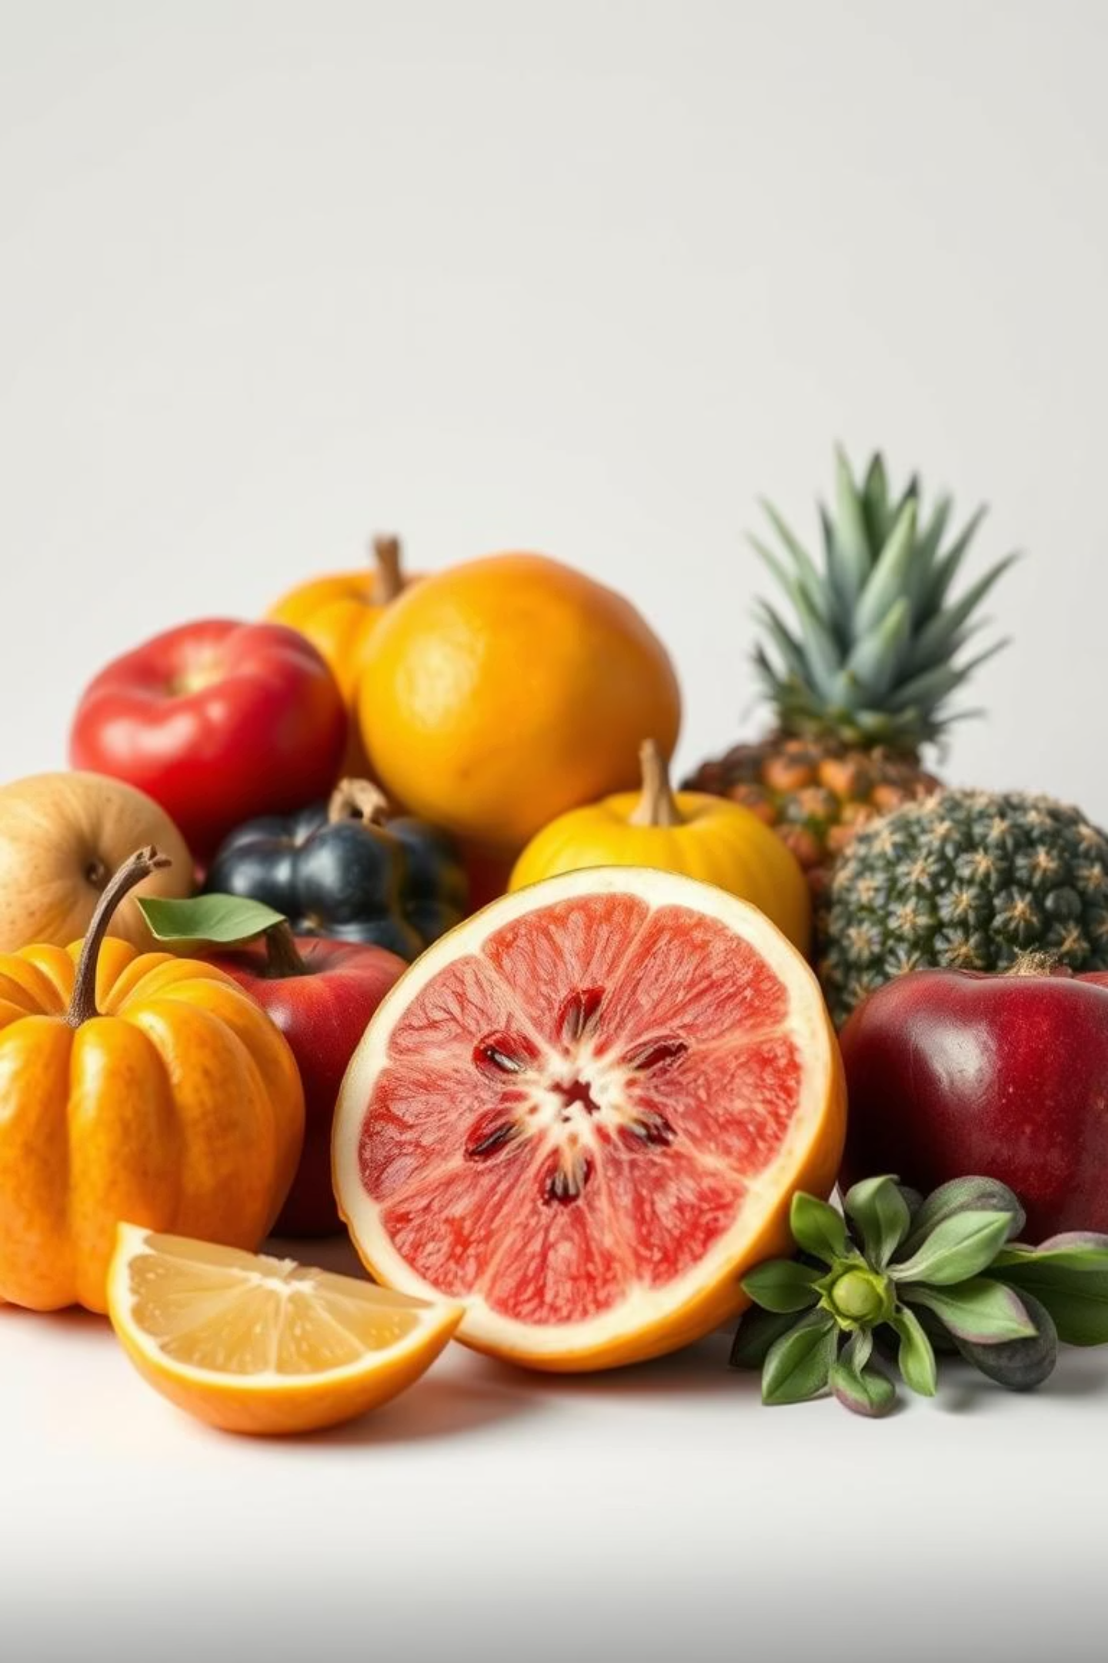
Fruit Image Classification
A CNN-based project with confusion matrix analysis.

Slide 2
Project Overview
Background
This project explores image classification using Convolutional Neural Networks (CNNs). We focus on identifying different types of fruits from images, a common task in computer vision with applications in agriculture, retail, and automated food sorting.
Objectives
Build a CNN model to classify fruit images.
Evaluate model performance using various metrics.
Analyse results via confusion matrix visualisation.

Slide 3
Dataset Description
We used a dataset of 360 images spanning 9 different fruit classes, sourced from Kaggle. The dataset was split into training, validation, and test sets with a 70/10/20 ratio.
Total Images
Fruit Classes
Image Size
360
9
224x224

Slide 4
Tools & Libraries
The project was implemented using a variety of Python libraries within a Jupyter Notebook environment.
Python: Primary programming language.
Jupyter Notebook: Interactive coding environment.
TensorFlow & Keras: Deep learning frameworks.
OpenCV: Image processing library.
Matplotlib: Data visualisation library.

Slide 5

Methodology: Data Preprocessing
The images were preprocessed to ensure consistency and improve model performance.
Data Verification: Checked for corrupted or invalid images.
Resizing: Resized all images to 224x224 pixels.
Colour Conversion: Converted images to RGB format.
Normalization: Scaled pixel values to the range [0, 1].

Slide 6
Methodology: CNN Architecture & Training
The CNN architecture consisted of the following layers:
Conv2D layers with ReLU activation
MaxPooling2D layers
Flatten layer
Dense layers with ReLU and softmax activation
Dropout layers for regularisation
The model was trained over 15 epochs using the Adam optimiser and categorical cross-entropy loss function.

Slide 7
Model Evaluation
Model performance was evaluated using the following metrics:
Accuracy and loss plots (training & validation)
Per-class analysis of prediction accuracy
Visualisation of a normalised confusion matrix

Slide 8
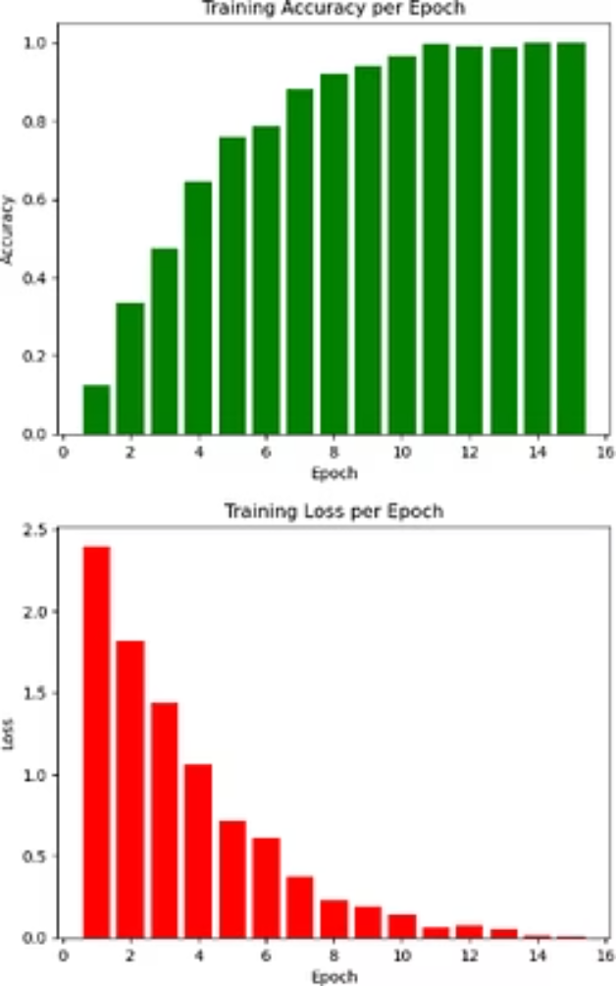
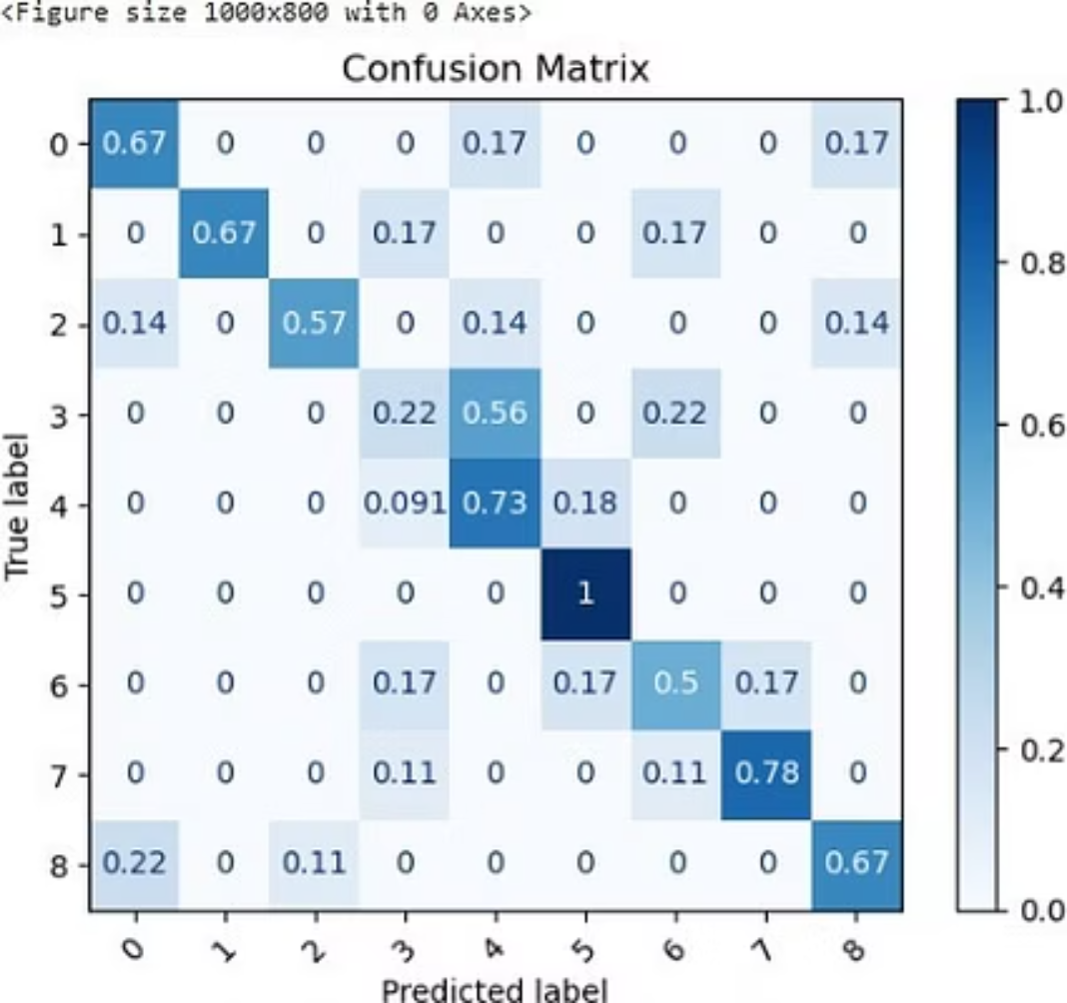
Results: Accuracy Metrics
The CNN model achieved excellent performance on the test dataset.
92%
95%
Validation Accuracy
Training Accuracy
Achieved on the validation set after 15 epochs.
End of training accuracy score
The confusion matrix provides insight into the model's performance on each fruit class.

Slide 9
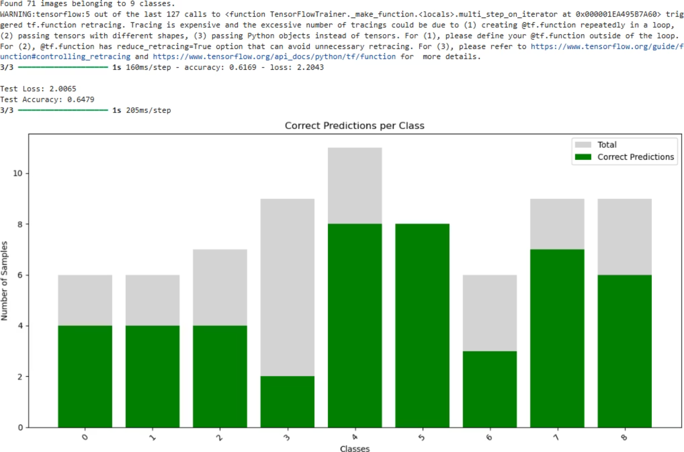
Results: The testing of model

Slide 10








Workflow
Data
Collect and organize raw image data for analysis.
Preprocess
Clean and transform data into a suitable format for the model.
Label
Assign appropriate categories to each image for supervised learning.
Split
Divide the dataset into training, validation, and test subsets.
Model
Design and train the Convolutional Neural Network architecture.
Evaluate
Assess the model's performance using defined metrics.
Visualise
Interpret results through charts and confusion matrices for insights.
Save
Store the trained model for future use and deployment.

Slide 11
Key Takeaways & Next Steps
This project demonstrates the effectiveness of CNNs for image classification tasks. We gained valuable experience in data preprocessing, model building, and performance evaluation.
Skills Gained: CNNs, TensorFlow, Image Processing.
Real-World Readiness: Applicable to various image-based applications.
Next Steps: Explore more advanced CNN architectures and larger datasets.
Created by Muhammad Umer & Muhammad Irtisam

